Slide 1
Figures by species
1
Present – seasonal maps, 2 depths
Future 245 – seasonal maps, 2 depths
Future 585 – seasonal maps, 2 depths
Future 245 – decadal and hovmuller
Future 585 – decadal and hovmuller

Slide 2
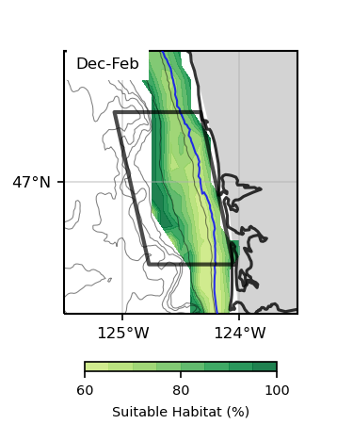
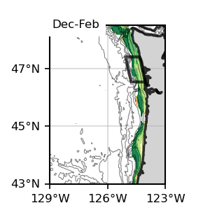
Surface
Bottom
1
1
Surface
Bottom
1
1

Slide 3
Dungeness Crab

Slide 4
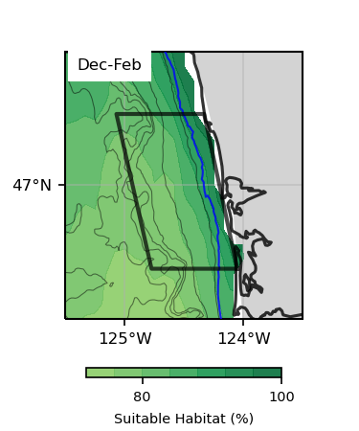
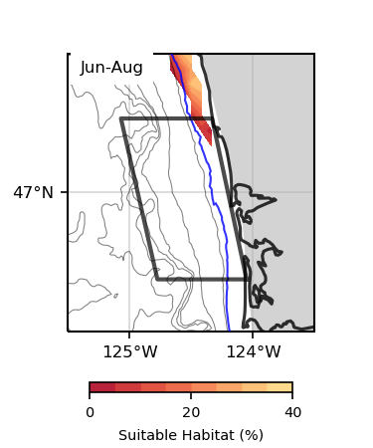
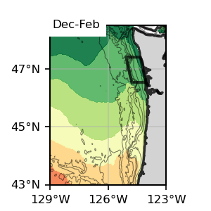
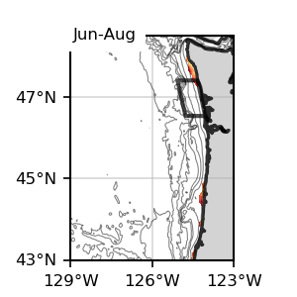
Surface
Surface
1
1
Dungeness Crab
Surface, present SSP245
1993-2019

Slide 5
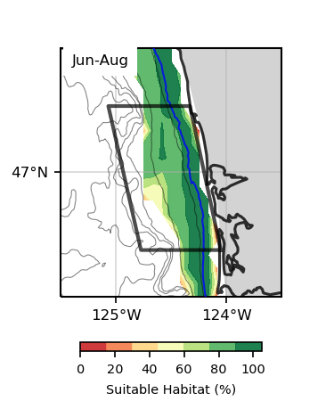
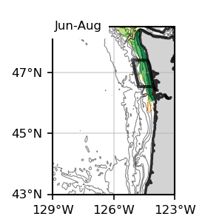
Bottom
Bottom
1
1
Dungeness Crab
Bottom, present SSP245
1993-2019

Slide 6
Surface
Bottom
1
1
Surface
Bottom
1
1

Slide 7
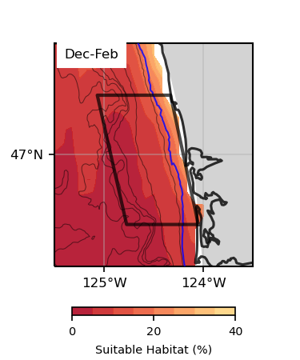
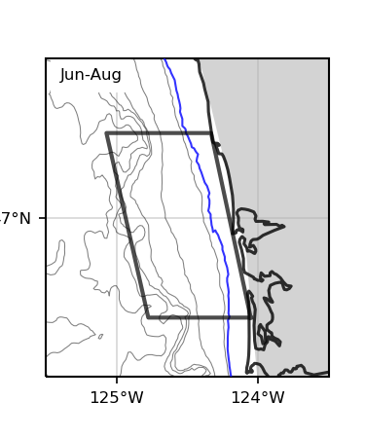
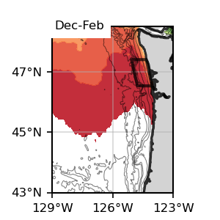
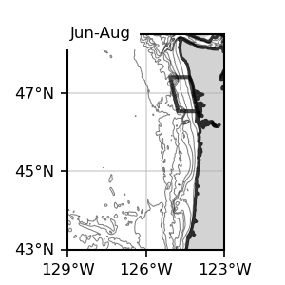
Surface
Surface
Dungeness Crab
Surface, Future, SSP 245
2060-2080

Slide 8
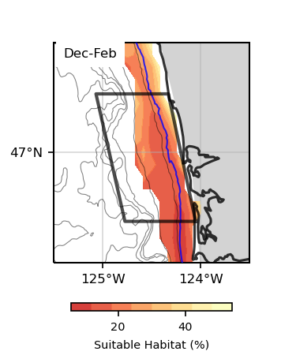
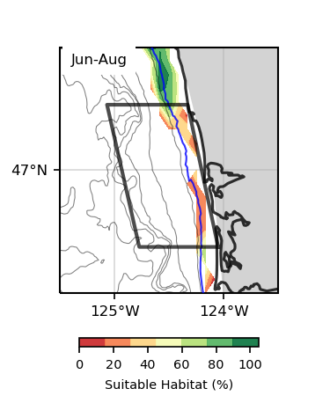
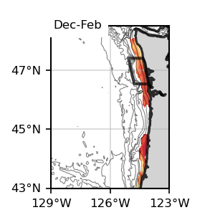
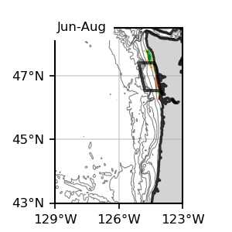
Bottom
Bottom
Dungeness Crab
Bottom, Future, SSP 245
2060-2080

Slide 9
Surface
Bottom
1
1
Surface
Bottom
1
1

Slide 10
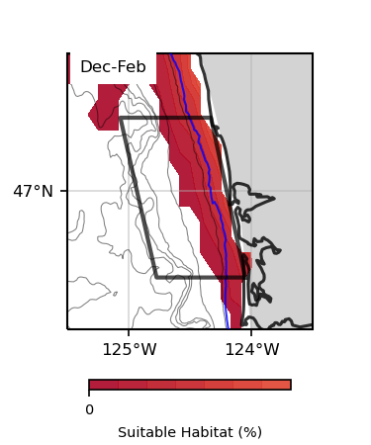
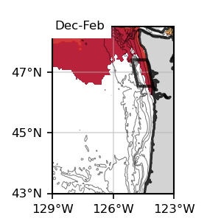
Surface
Surface
Dungeness Crab
Surface, Future, SSP 585
2060-2080

Slide 11
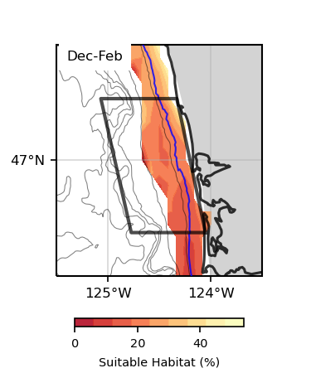
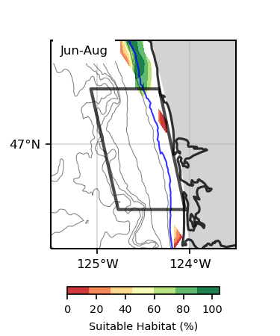
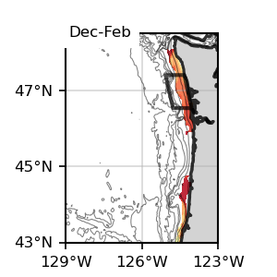
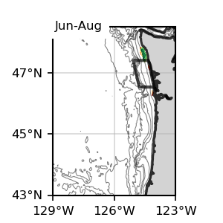
Bottom
Bottom
Dungeness Crab
Bottom, Future, SSP 585
2060-2080

Slide 12
Surface
Bottom
1
1
Surface
Bottom
1
1

Slide 13
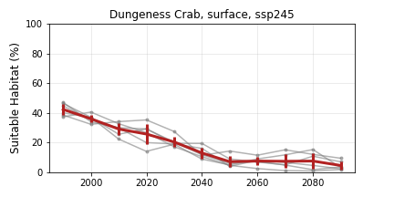
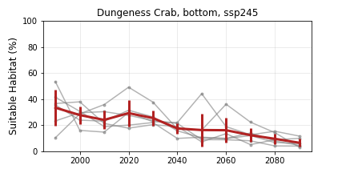
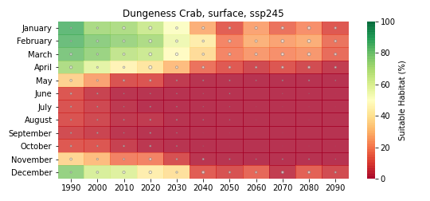
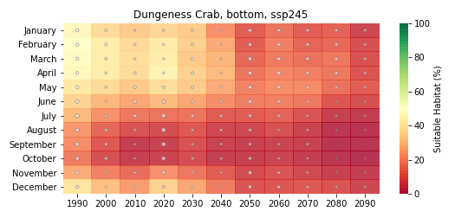
Dungeness Crab
Future, SSP 245

Slide 14
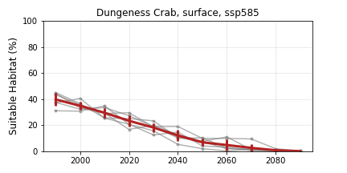
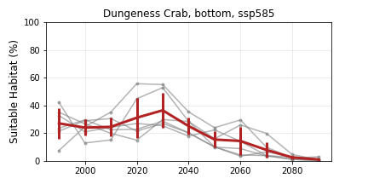
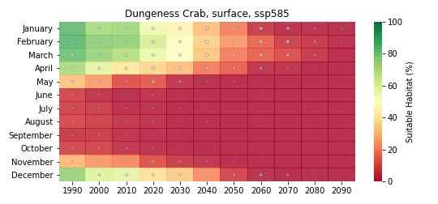
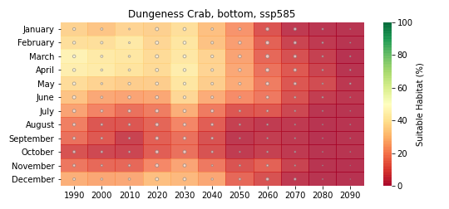
Dungeness Crab
Future, SSP 585

Slide 15
Sablefish

Slide 16
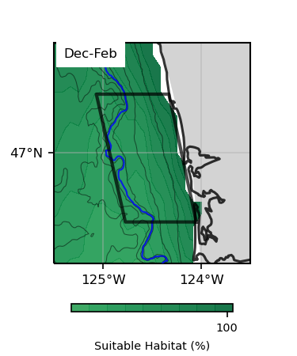
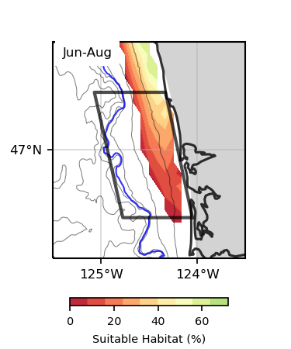
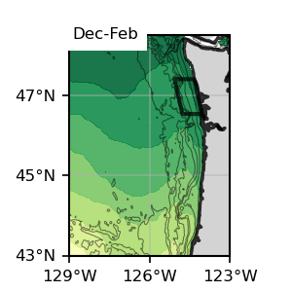
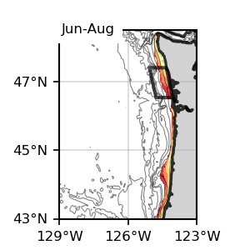
Surface
Surface
1
1
Sablefish
Surface, present SSP245
1993-2019

Slide 17
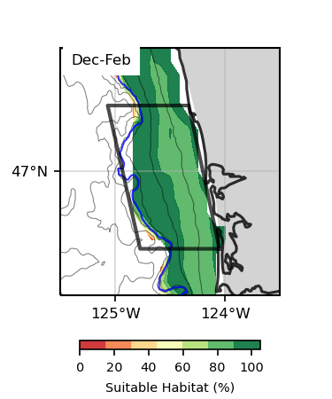
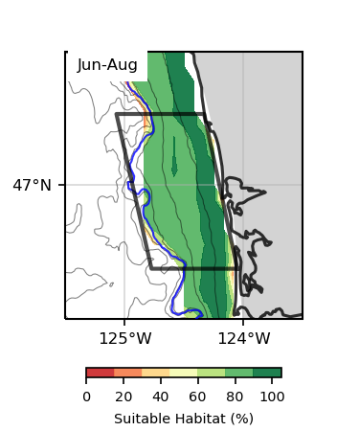
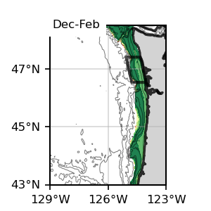
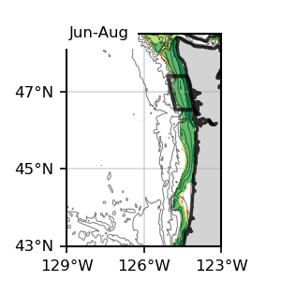
Bottom
Bottom
1
1
Sablefish
Bottom, present SSP245
1993-2019

Slide 18
Surface
Bottom
1
1
Surface
Bottom
1
1

Slide 19
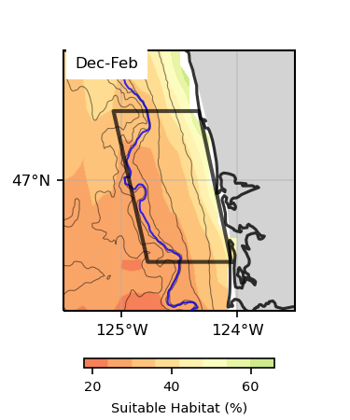
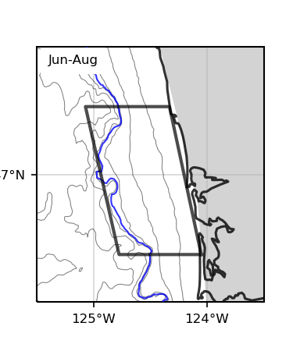
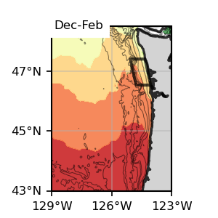
Surface
Surface
1
1
Sablefish
Surface, Future 245
2060-2080

Slide 20
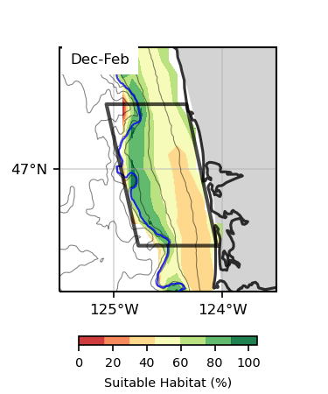
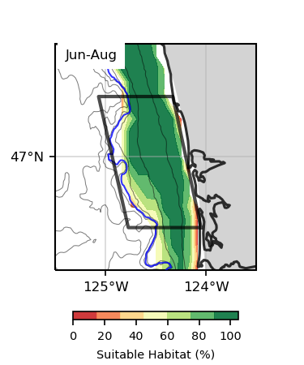
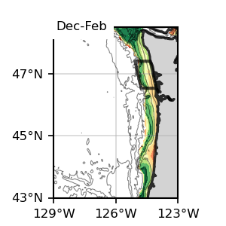
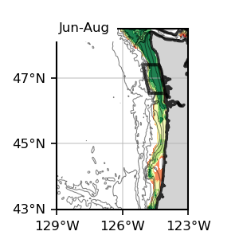
Bottom
Bottom
1
1
Sablefish
Bottom, Future 245
2060-2080

Slide 21
Surface
Bottom
1
1
Surface
Bottom
1
1

Slide 22
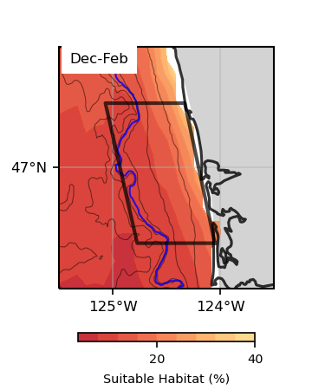
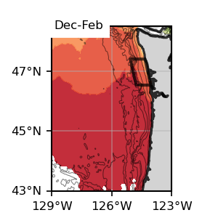
Surface
Surface
1
1
Sablefish
Surface, Future 585
2060-2080

Slide 23
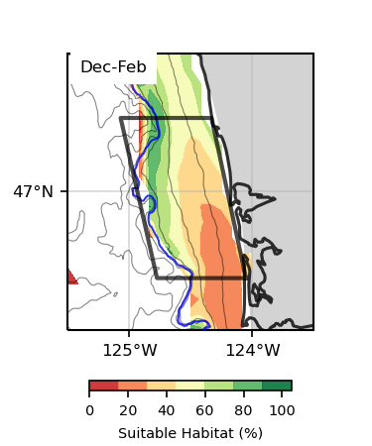
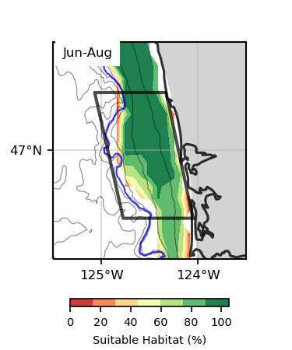
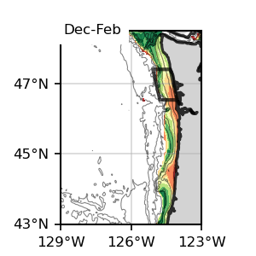

Bottom
Bottom
1
1
Sablefish
Bottom, Future 585
2060-2080

Slide 24
Surface
Bottom
1
1
Surface
Bottom
1
1

Slide 25




Sablefish
Future 245

Slide 26




Sablefish
Future 585

Slide 27
Halibut

Slide 28



Surface
Surface
1
1
Halibut
Surface, present SSP245
1993-2019

Slide 29




Bottom
Bottom
1
1
Halibut
Bottom, present SSP245
1993-2019

Slide 30
Surface
Bottom
1
1
Surface
Bottom
1
1

Slide 31



Surface
Surface
1
1
Halibut
Surface, Future 245
2060-2080

Slide 32




Bottom
Bottom
1
1
Halibut
Bottom, Future 245
2060-2080

Slide 33
Surface
Bottom
1
1
Surface
Bottom
1
1

Slide 34

Surface
Surface
1
1
Halibut
Surface, Future 585
2060-2080

Slide 35



Bottom
Bottom
1
1
Halibut
Bottom, Future 585
2060-2080

Slide 36
Surface
Bottom
1
1
Surface
Bottom
1
1

Slide 37




Halibut
Future 245

Slide 38




Halibut
Future 585

Slide 39
Chinook

Slide 40




Surface
Surface
1
1
Chinook
Surface, present SSP245
1993-2019

Slide 41




Bottom
Bottom
1
1
Chinook
Bottom, present SSP245
1993-2019

Slide 42
Surface
Bottom
1
1
Surface
Bottom
1
1

Slide 43



Surface
Surface
1
1
Chinook
Surface, Future 245
2060-2080

Slide 44




Bottom
Bottom
1
1
Chinook
Bottom, Future 245
2060-2080

Slide 45
Surface
Bottom
1
1
Surface
Bottom
1
1

Slide 46


Surface
Surface
1
1
Chinook
Surface, Future 585
2060-2080

Slide 47




Bottom
Bottom
1
1
Chinook
Bottom, Future 585
2060-2080

Slide 48
Surface
Bottom
1
1
Surface
Bottom
1
1

Slide 49




Chinook
Future 245

Slide 50




Chinook
Future 585

Slide 51
Coho

Slide 52




Surface
Surface
1
1
Coho
Surface, present SSP245
1993-2019

Slide 53




Bottom
Bottom
1
1
Coho
Bottom, present SSP245
1993-2019

Slide 54
Surface
Bottom
1
1
Surface
Bottom
1
1

Slide 55



Surface
Surface
1
1
Coho
Surface, Future 245
2060-2080

Slide 56




Bottom
Bottom
1
1
Coho
Bottom, Future 245
2060-2080

Slide 57
Surface
Bottom
1
1
Surface
Bottom
1
1

Slide 58


Surface
Surface
1
1
Coho
Surface, Future 585
2060-2080

Slide 59




Bottom
Bottom
1
1
Coho
Bottom, Future 585
2060-2080

Slide 60
Surface
Bottom
1
1
Surface
Bottom
1
1

Slide 61




Coho
Future 245

Slide 62




Coho
Future 585

Slide 63
Razor Clams

Slide 64




Surface
Surface
1
1
Razor Clams
Surface, present SSP245
1993-2019

Slide 65




Bottom
Bottom
1
1
Razor Clams
Bottom, present SSP245
1993-2019

Slide 66
Surface
Bottom
1
1
Surface
Bottom
1
1

Slide 67



Surface
Surface
1
1
Razor Clams
Surface, Future 245
2060-2080

Slide 68




Bottom
Bottom
1
1
Razor Clams
Bottom, Future 245
2060-2080

Slide 69
Surface
Bottom
1
1
Surface
Bottom
1
1

Slide 70


Surface
Surface
1
1
Razor Clams
Surface, Future 585
2060-2080

Slide 71




Bottom
Bottom
1
1
Razor Clams
Bottom, Future 585
2060-2080

Slide 72
Surface
Bottom
1
1
Surface
Bottom
1
1

Slide 73




Razor Clams
Future 245

Slide 74




Razor Clams
Future 585

Slide 75
Albacore

Slide 76




Surface
Surface
1
1
Albacore
Surface, present SSP245
1993-2019

Slide 77

Bottom
Bottom
1
1
Albacore
Bottom, present SSP245
1993-2019

Slide 78
Surface
Bottom
1
1
Surface
Bottom
1
1

Slide 79




Surface
Surface
1
1
Albacore
Surface, Future 245
2060-2080

Slide 80


Bottom
Bottom
1
1
Albacore
Bottom, Future 245
2060-2080

Slide 81
Surface
Bottom
1
1
Surface
Bottom
1
1

Slide 82




Surface
Surface
1
1
Albacore
Surface, Future 585
2060-2080

Slide 83


Bottom
Bottom
1
1
Albacore
Bottom, Future 585
2060-2080

Slide 84
Surface
Bottom
1
1
Surface
Bottom
1
1

Slide 85




Albacore
Future 245

Slide 86




Albacore
Future 585

